Slide 1

Future of Metabolomics
Knowledge that will change your world
Ist UAB Metabolomics Workshop
June 2-5, 2014
Stephen Barnes, PhD
Director, Targeted Metabolomics and Proteomics Laboratory

Slide 2
Issues in metabolomics research
Standards and methods standardization
Derivatives and Isotope labeling
Capillary electrophoresis
Spatial distribution
  Imaging mass spectrometry
Other localized metabolomics
  Head space GC-MS
    Breath and other body odors
    ?? urine “odor”
  iKnife-MS
    Metabolome of the “smoke” created with cauterized surgical knife
Big picture - Phenomics
Where next?

Slide 3
Standards
The majority of compounds that are detected have not been fully characterized and don’t exist in pure standard form
The LipidMaps endeavor (www.lipidmaps.org) has gone a long way to improve the state of that field
A heavy investment in chemical synthesis of other metabolites is sorely needed

Slide 4
http://www.metabolomicsworkbench.org/standards/nominatecompounds.cgi
Nominate Compounds for Synthesis by the Metabolite Standards Synthesis Core (MSSC)
The NIH Common Fund’s Metabolomics program aims to increase national capacity in metabolomics by supporting the development of next generation technologies to enhance the sensitivity and speed with which specific elements of the cellular metabolome can be identified and quantified, providing training and mentoring opportunities, increasing the inventory of chemically identifiable metabolites through the synthesis and availability of high quality reference standards, and by promoting data sharing and collaboration.
The form should be completed by researchers wishing to nominate a compound for synthesis by the NIH Common Fund’s Metabolite Standards Synthesis Cores (MSSC). Nominated compounds will be reviewed by the NIH Common Fund’s executive committee, and prioritized for synthesis.

Slide 5
Standardized methods
Importance of standardized operating procedures and recording keeping of any deviations from them – use of LIMS
NMR yields absolute, quantitative data, but for a limited number of metabolites
Whereas LC-MS is very sensitive, quantification is a challenge
For primary untargeted metabolomics data collection, the Qtof instrument is both the fastest and most robust
  The UK NIHR Phenomics Center is using a single manufacturer’s Qtof - harmonization

Slide 6
Back to derivatization in metabolomics
A great advantage of LC-MS is its ability to measure compounds “as is”
However, there are many compounds that either weakly form ions or are found in multiple chemical forms (e.g., steroids, ketosteroids, keto acids, fatty acids)
The reagents used to overcome this problem can be isotopically labeled (iMetab)

Slide 7
5.21
4.0e6
Succinate with no
Amplifex™ treatment
3.0e6
Individual MRM channels for citric acid cycle intermediates
For most compounds, the MRM signal yields a single peak
Note that the signal for oxaloacetate is weak and “ugly” – keto acids can undergo keto-enol tautomerism
2.0e6
1.0e6
Intensity, cps
0.0
2
4
6
8
10
12
14
Time, min
4.45
4.0e6
OH-Glutarate with no
Amplifex™ treatment
3.0e6
2.0e6
1.0e6
Intensity, cps
0.0
2
4
6
8
10
12
14
Time, min
Oxaloacetate with no
Amplifex™ treatment
6000
5000
4000
3000
2000
Intensity, cps
1000
0
2
4
6
8
10
12
14
Time, min

Slide 8
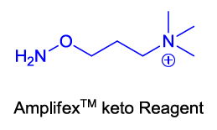
Modifiers to the keto group
Methoxylamine – CH₃ONH₂ (from GC-MS)
Biotin hydrazide – RN.NH₂
Amplifex™-Keto Reagent (ketosteroids)
R
||
C—OH
|
R¹
R
C=O
R¹
Enol Keto

Slide 9
5.88
3.0e6
Succinate
2.5e6
2.0e6
1.5e6
1.0e6
5.0e5
Intensity, cps
0.0
2
4
6
8
10
12
14
Time, min
Oxaloacetate is converted to a stabilized, positively charged oxime The reagent does not alter succinate or 2-OH glutarate
4.33
5.0e6
OH-Glutarate
4.0e6
3.0e6
2.0e6
1.0e6
Intensity, cps
0.0
2
4
6
8
10
12
14
Time, min
1.00e6
4.71
8.00e5
Oxaloacetate
6.00e5
4.00e5
2.00e5
Intensity, cps
0.00
2
4
6
8
10
12
14
Time, min

Slide 10
Isotopic derivatization
investigators are exploring reagents that can be coupled to –NH₂ and –COOH groups
  c.f., ICAT, iTRAQ and TMT reagents for proteomics
These may allow one sample of a pair to be labeled with a “light” reagent and another sample with the same reagent, but one incorporating ²H, ¹³C or ¹⁵N atoms and therefore being “heavy”.
  The two samples can then be mixed and run at the same time
  Multiplexed reagents are also possible
Software to sort this out has not yet been written

Slide 11
Capillary electrophoresis-MS and metabolomics
“Capillary electrophoresis and MS is a marriage made in heaven, but not on earth” (Richard Smith, 1994)
Can CE-MS provide for metabolomics what CE has done for DNA deep sequencing?
CE has many forms and can accommodate a wide variety of even hydrophilic compounds
The interface is the key component

Slide 12
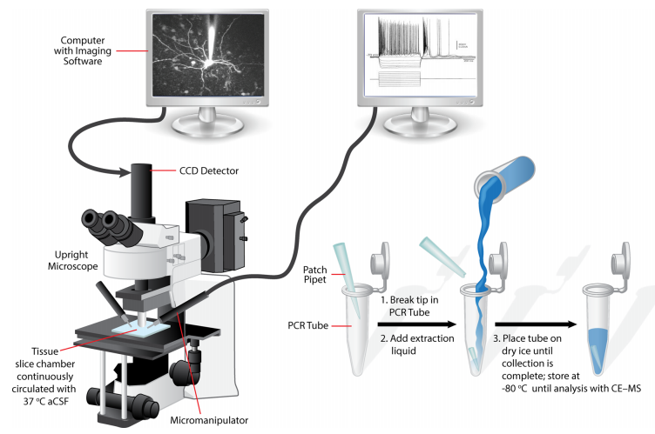
Aerts et al., Anal Chem 86:3203 (2014)

Slide 13
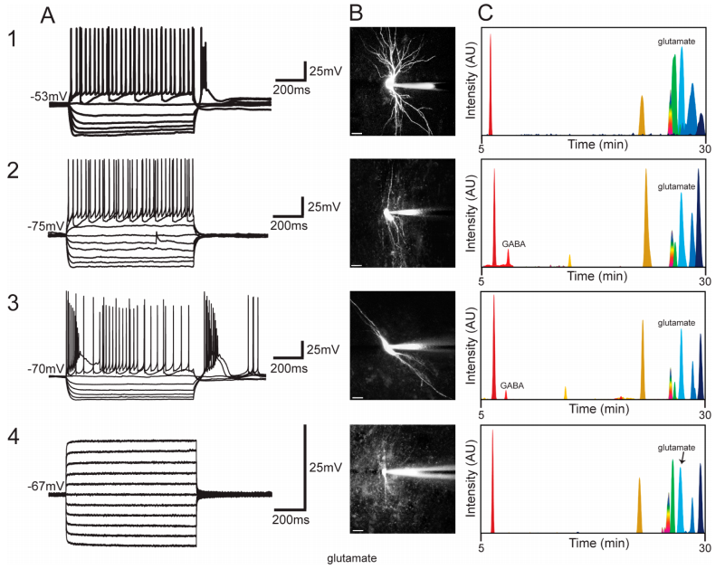
Aerts et al., Anal Chem 86:3203 (2014)

Slide 14
Can we improve the chromatography?
The sheer numbers of metabolites demands a better chromatographic solution
  CE-MS is one answer
Taking a leaf from the gas chromatography community, LC needs to move towards open tubular columns
  The back pressure of smaller and smaller particles is limiting
  So, get rid of the particles

Slide 15
Where are the metabolites?

Slide 16
Understanding where metabolites are
When we collect the metabolites from tissue or from cells, we destroy their localization information
We assume that all metabolites are in contact with each other
But there as many as 15 distinct compartments in cells
Some cells rely on neighboring cells for specific metabolites

Slide 17
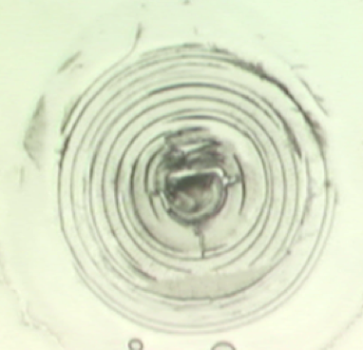
Frozen, thin section of zebrafish lens
Concentric rings in the cortical region
Nuclear zone
Miranda Collier, 2013

Slide 18
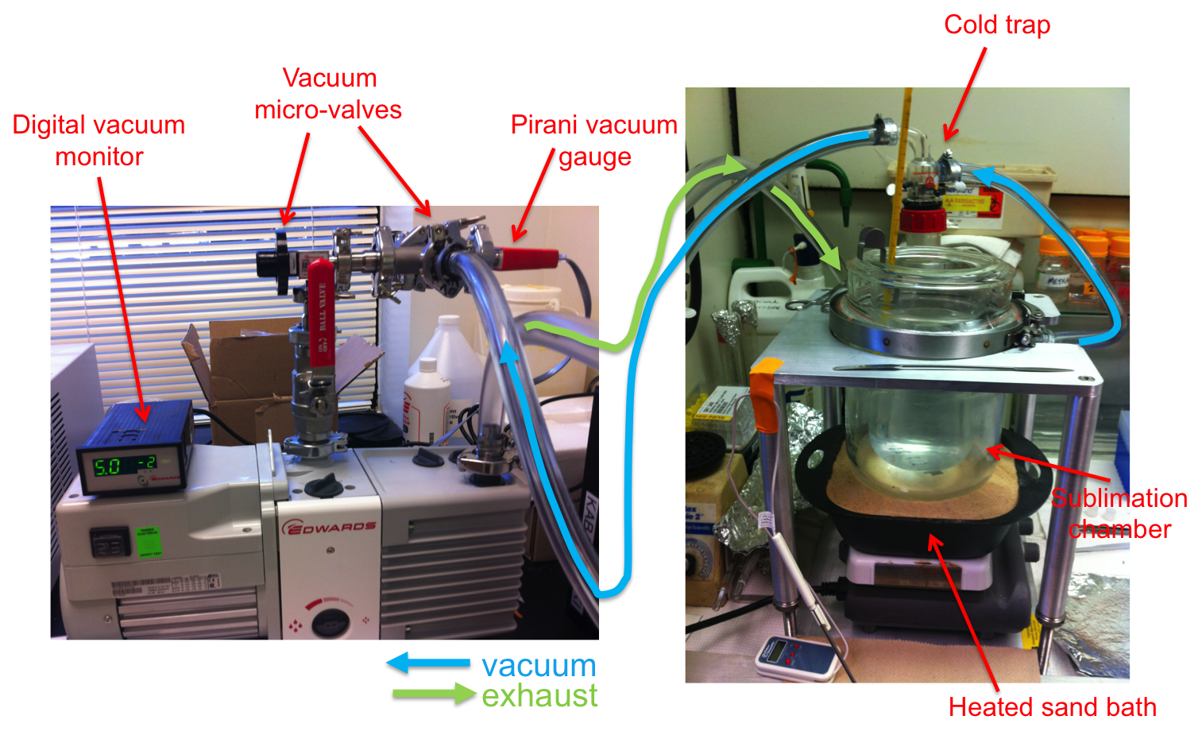

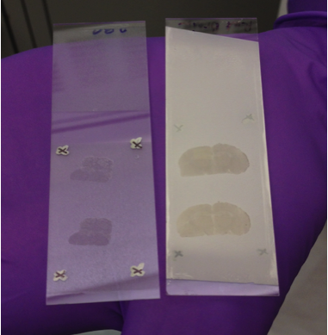
Matrix application – vacuum sublimation
Sublimation setup:
2,5-dihydroxybenzoic acid
Miranda Collier/Janusz Kabarowski

Slide 19
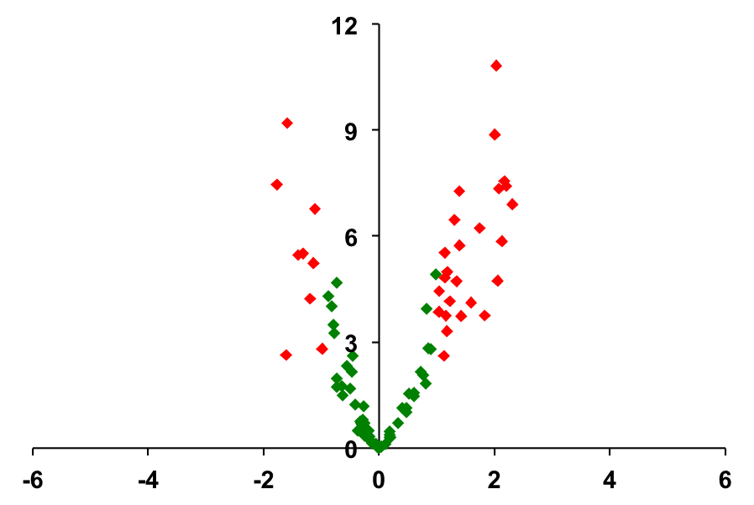
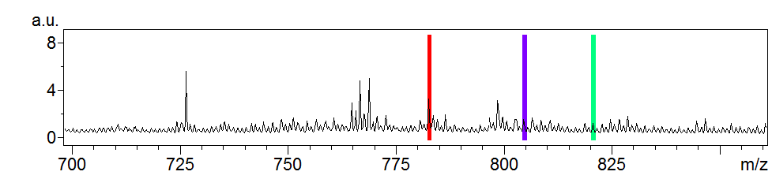
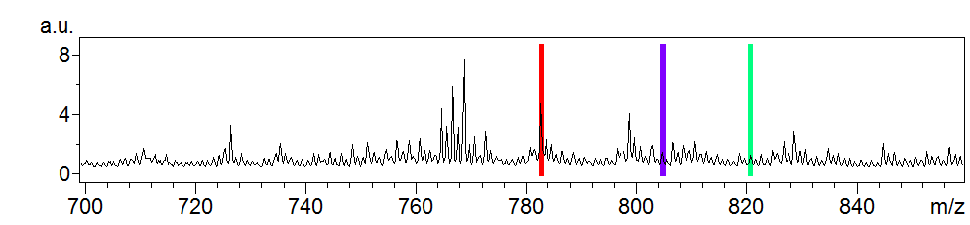
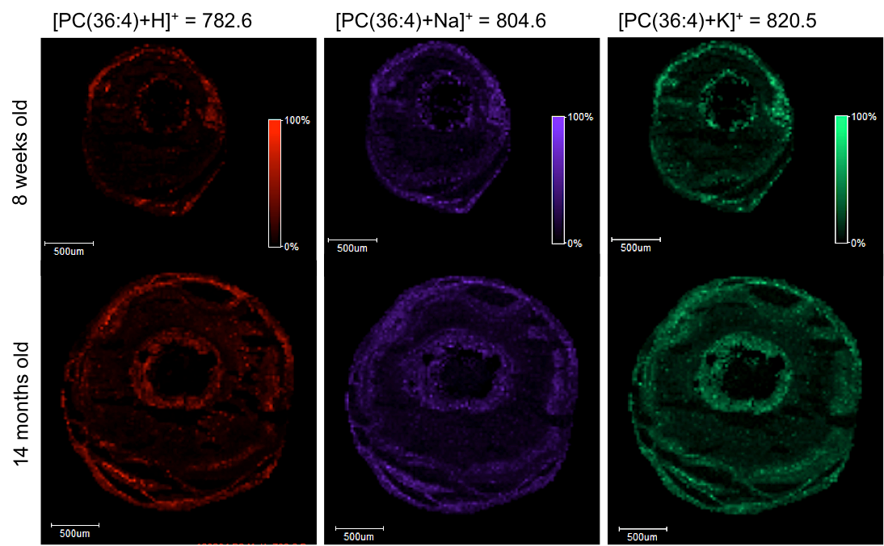
Selection of peaks from average mass spectrum reveals ion distribution in tissue
8 weeks old
-log₁₀(p)
PC(36:4)
14 months old
log₂FC
Lipids exist in situ as protonated, sodiated, or potassiated adducts
Formation of lithium adducts can improve signal and deconvolute spectra
Miranda Collier/Janusz Kabarowski

Slide 20
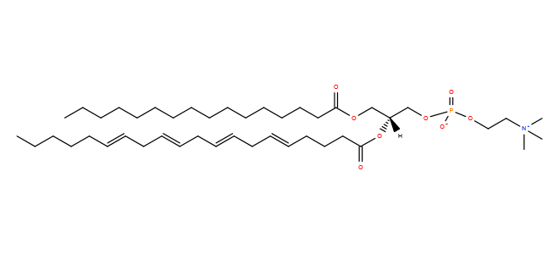
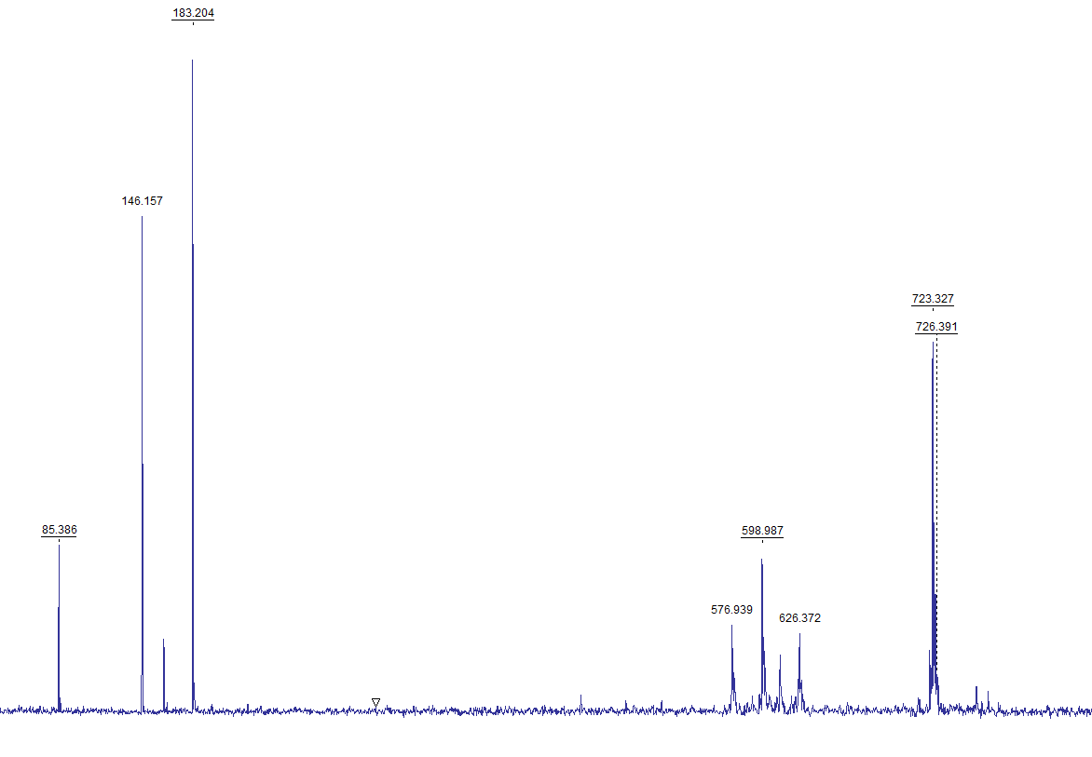
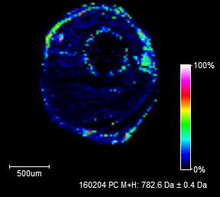
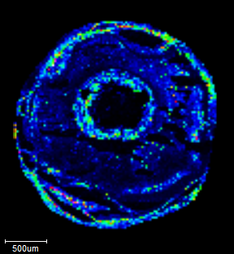
MALDI MS/MS confirms lipid identities
choline head group
m/z 782.6
8 weeks old
(36:4) phospholipid
14 months old
100 200 300 400 500 600 700 800
Mass/Charge (m/z), Da
Miranda Collier/Janusz Kabarowski

Slide 21
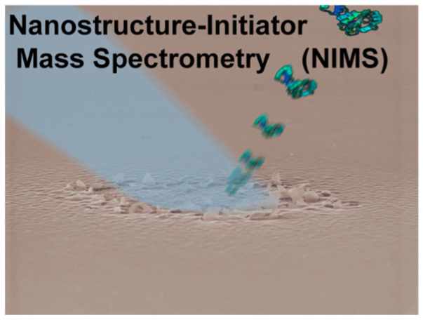
Greving et al. 2011

Slide 22
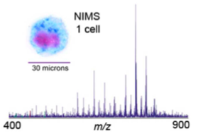
Spectrum from a single cell
Greving et al. 2011

Slide 23
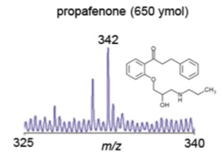
Extreme sensitivity
Greving et al. 2011

Slide 24
Metabolism and time
Not only should metabolites appear in the right place, there is also the question of the importance of the timescale
Metabolism defects in the heart may be only seconds away from death – rogue wave in metabolism??
Irreversible damage to the brain may occur in minutes
Go/No-Go decisions for a cell to divide or apoptose may occur in a similar timescale

Slide 25
Components of breath
Two types of components
  Droplets in exhaled breath
    Can be condensed (proteins, lipids, metabolites)
    LC-MS analysis
  True volatiles (requires GC-MS)
    Non-condensable gases
      H₂, N₂, O₂, CO₂
    Organics
      Alcohols, aldehydes, alkanes

Slide 26
Detecting smells
Unlike dogs, humans have relatively few olefactory receptors (dogs have lousy taste!)
  We can detect certain “bad smells” (and cover these by washing and deodorants and fragrances)
The reality is that we all emit gases that can be diagnostic
  GC-MS using a headspace technique can be used
    Breath hydrogen is diagnostic for lactase insufficiency

Slide 27
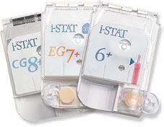
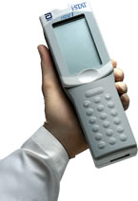
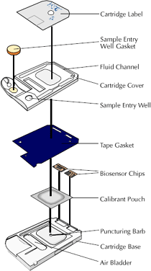
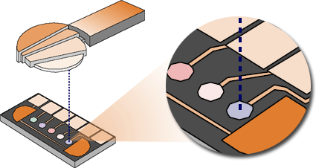
Portable Metabolomics Devices
David Wishart

Slide 28
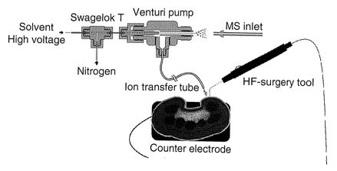
iKnife mass spectrometry
Electrospray post ionization mass spectrometry of electrosurgical aerosols. Guenther et al., JASMS 2011

Slide 29
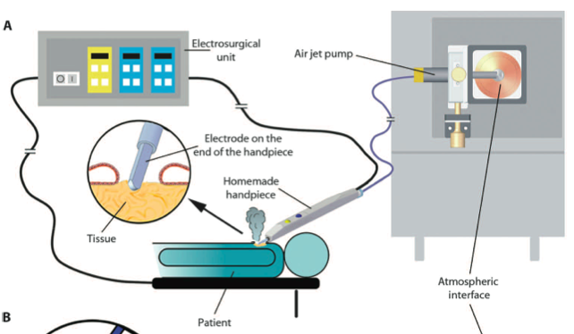
The iKnife – real time metabolomics
Balog et al. Nature Med 5; 194r93

Slide 30
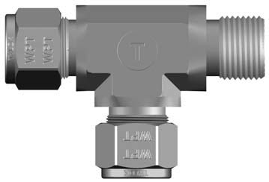
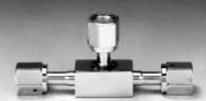


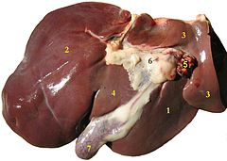
iKnife device
Venturi pump
Veriflo VAC 100
Mass spectrometer
Solvent
25 μl/min
Infusion
pump
Teflon transfer tubing
N₂ gas
RadioSurg 220

Slide 31
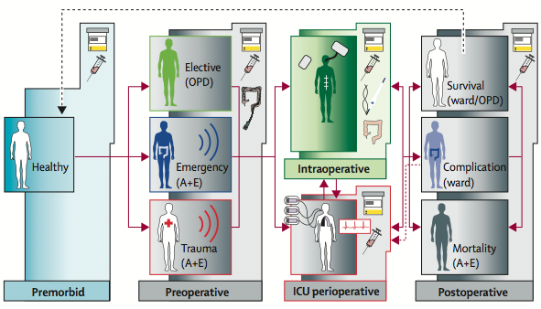
Clinical applications of metabolomics
Concepts of Jeremy Nicholson

Slide 32
The UK NIHR Phenome Center
http://www1.imperial.ac.uk/phenomecentre/

Slide 33
Can existing techniques provide answers?
Mass spec is mostly a destructive method
  However, it can measure volatiles rapidly on a sec timescale
NMR can provide spatial and descriptive information on living or unextracted materials
  However, sensitivity and speed of data acquisition are extremely limiting
Future in other spectroscopic techniques?

Slide 34
Where next?
“Whatever you’re using now to measure metabolites, in 10 years it will be something different”
– Stephen Barnes, Metabolomics Society 2013
“Throughout history, people with new ideas—who think differently and try to change things—have always been called troublemakers.”
― Richelle Mead, Shadow Kiss

